Slide 1
Dihedral Angles
Techno-Titans

Slide 2
A dihedral angle of a protein is the internal angle of the polypeptide backbone at which two adjacent planes meet. The confirmation of the backbone can be described by two dihedral angles per residue, because the backbone residing between two juxtaposing Cα atoms are all in a single plane.
The angles which involves the backbone atoms C-N-Cα-C is φ (phi)
The angles which involves the backbone atoms N-Cα-C-N is ψ (psi)
The angles which involves the backbone atoms Cα-C-N-Cα is ω (omega)

Slide 3
Algorithm
We are using atan2() instead of acos2() as angle returned by atan2() is from 0 to 2π instead of 0 or ±π
1
2
3
4
Given the coordinates of the four points, obtain the vectors b1, b2, and b3 by vector subtraction
Let me use the nonstandard notation ⟨v⟩ to denote v/∥v∥, the unit vector in the direction of the vector v. Compute n1=⟨b1×b2⟩ and n2=⟨b2×b3⟩, the normal vectors to the planes containing b1 and b2, and b2 and b3 respectively. The angle we seek is the same as the angle between n1 and n2
The three vectors n1, ⟨b2⟩, and m1:=n1×⟨b2⟩ form an orthonormal frame. Compute the coordinates of n2 in this frame: x=n1⋅n2 and y=m1⋅n2. (You don't need to compute ⟨b2⟩⋅n2 as it should always be zero.)
The dihedral angle, with the correct sign, is atan2(y,x)

Slide 4
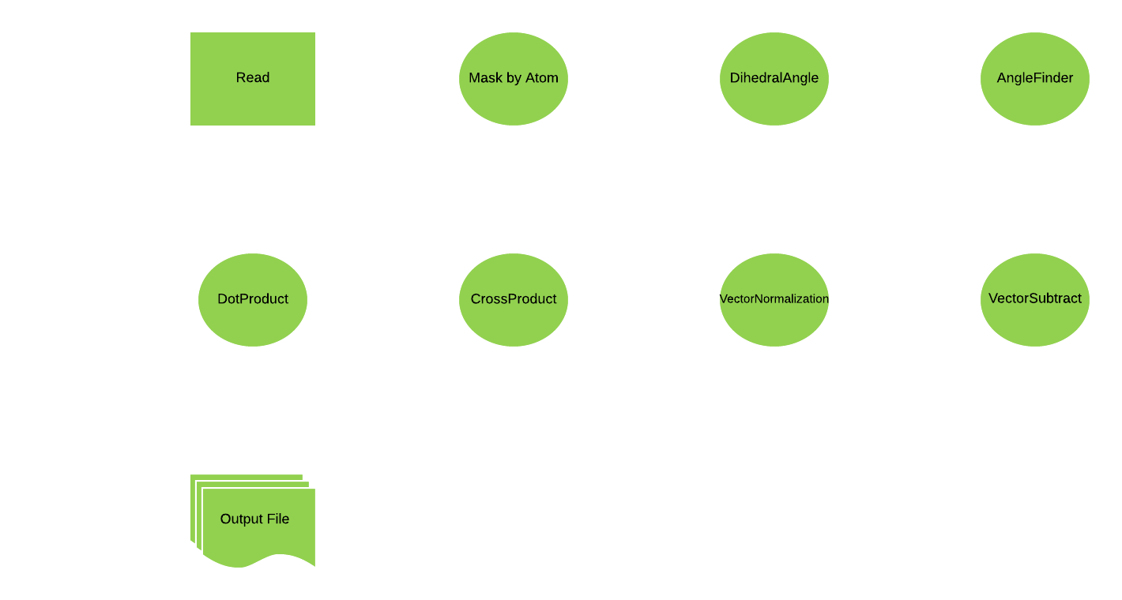
Data Flow Diagram

Slide 5
Execution Time(secs)
Frames | Test 1 in sec | Test 2 in sec
20 | 23 | 19
100 | 89 | 78
1000 | 827 | 880

Slide 6
APIs
Dihedral.vectorSubtract(vector coordinates :Double) : List[Double]
Parameters :
v<i>_<xi/yi/zi>: Coordinates of two vectors
Returns : list of vectors subtraction
Functionality : computes vector subtraction
Dihedral.crossProduct(vector coordinates :Double) : List[Double]
Parameters :
v<i>_<xi/yi/zi>: Coordinates of two vectors
Returns : list
Functionality : computes cross product of two vectors

Slide 7
APIs
Dihedral.dotProduct(vector coordinates :Double) : List[Double]
Parameters :
v<i>_<xi/yi/zi>: Coordinates of two vectors
Returns : Double
Functionality : computes the dot product of two vectors
Dihedral.vectorNormalization(vector coordinates :Double) : List[Double]
Parameters :
v<i>_<xi/yi/zi>: Coordinates of two vectors
Returns : List
Functionality : computes unit vector

Slide 8
APIs
Dihedral.angleFinder(vector coordinates :Double) : List[Double]
Parameters :
v<A/B/C/D>_<xi/yi/zi>: Coordinates of four vectors
Returns : double
Functionality : finds dihedral angle between four coordinates
Dihedral.dihedralAngle(DF : Dataset[PDB]) : List[Double]
Parameters :
dataset : Dataset that contains the coordinates of all the frame.
Returns : String
Functionality : inputs the coordinates and returns psi( ψ), phi(φ ) and omega(ω)

Slide 9
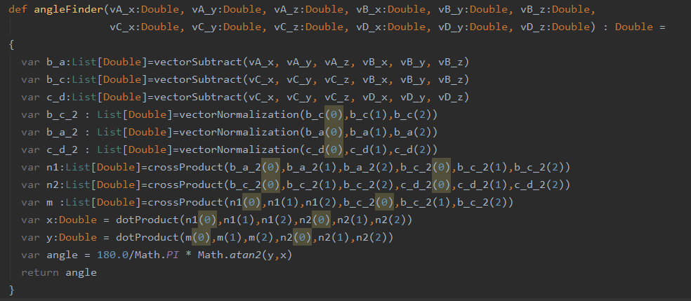
Code Snippet

Slide 10
Thank You
MIT2019068
MIT2019070
MIt2019058

